Slide 1
Feature Introduction
Personal Call Handling
July 2023

Slide 2
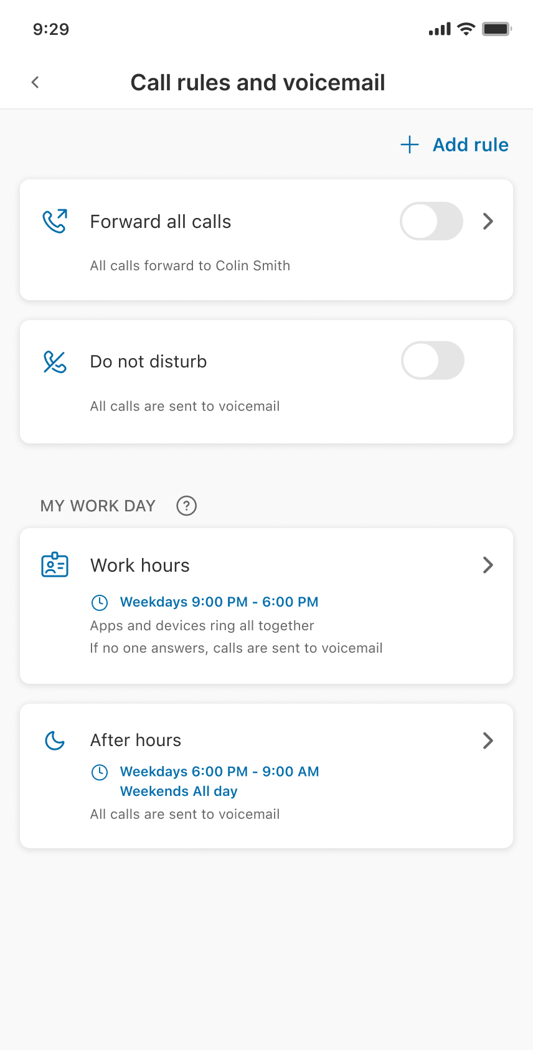
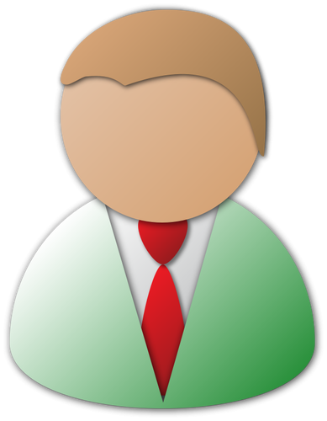
Personal Call Handling
How it works
Call rules make it easy to setup how your incoming calls are answered
PSTN

Slide 3
Personal Call Handling
What’s New - Call rules & voicemail
New call rule design makes it easy to setup how your calls are handled
Call rules include your greeting, ring, and missed call settings
Create custom call rules from your desktop and mobile apps
Activate and manage all of your call rules from anywhere
Admin Portal Phone settings have been updated to align with desktop and mobile apps

Slide 4
Personal Call Handling
How it works
New call rules make it easy to setup how your incoming calls are answered

Slide 5
Personal Call Handling
How it works
Customize the greetings incoming callers will hear

Slide 6
Personal Call Handling
How it works
Set how your devices and numbers ring

Slide 7
Personal Call Handling
How it works
If you don’t answer, set how missed calls are handled

Slide 8
Personal Call Handling
How it works
Set a schedule if you want incoming calls to be handled differently based on day/time

Slide 9
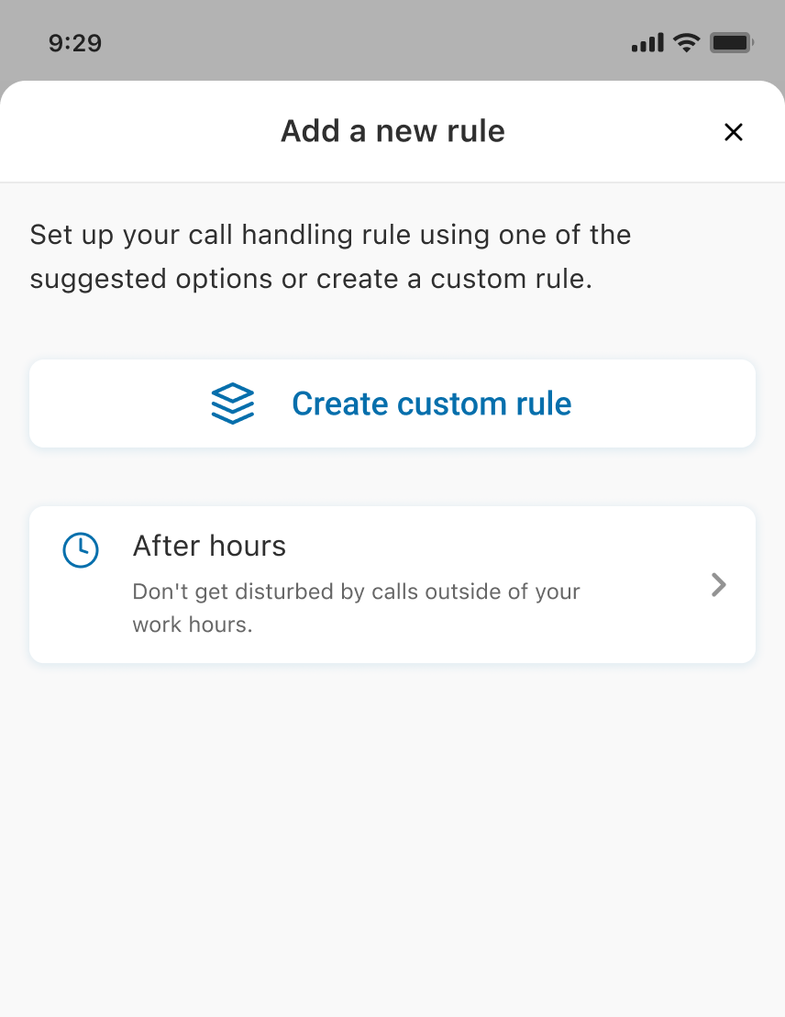
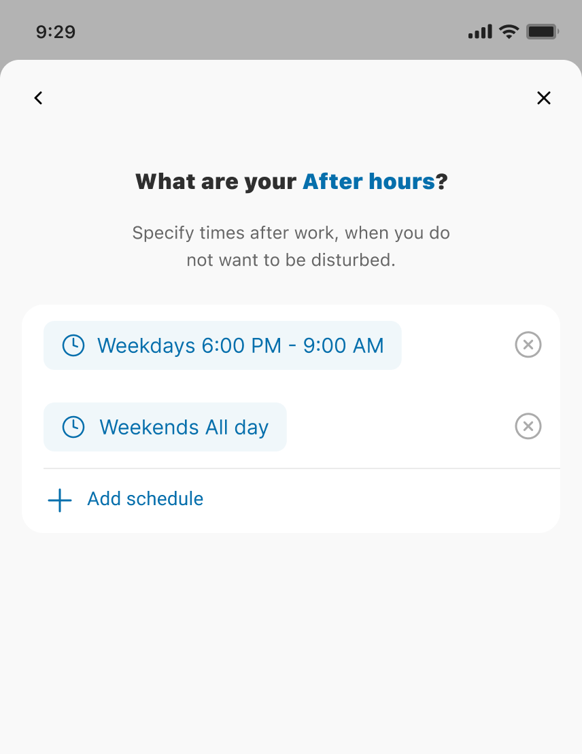
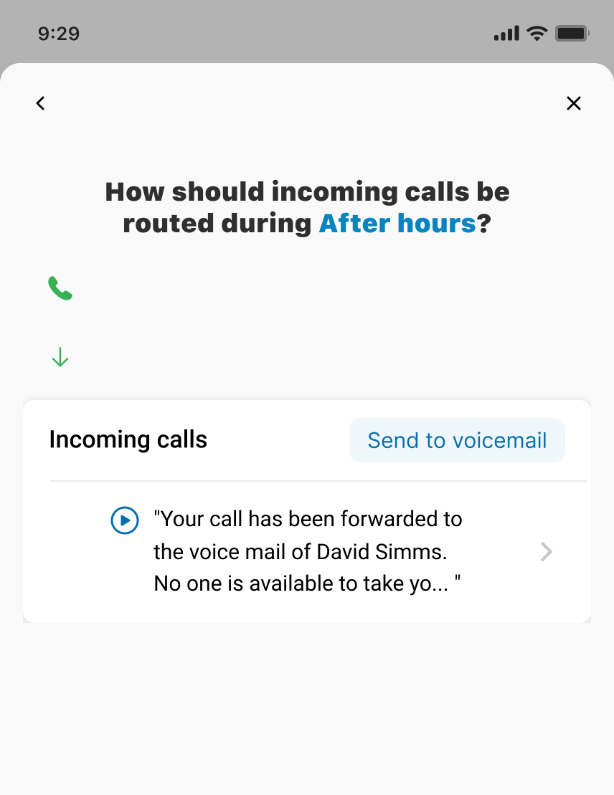
Personal Call Handling
How it works
We make it easy to setup any call rule you need
Add call rules from your Mobile apps

Slide 10
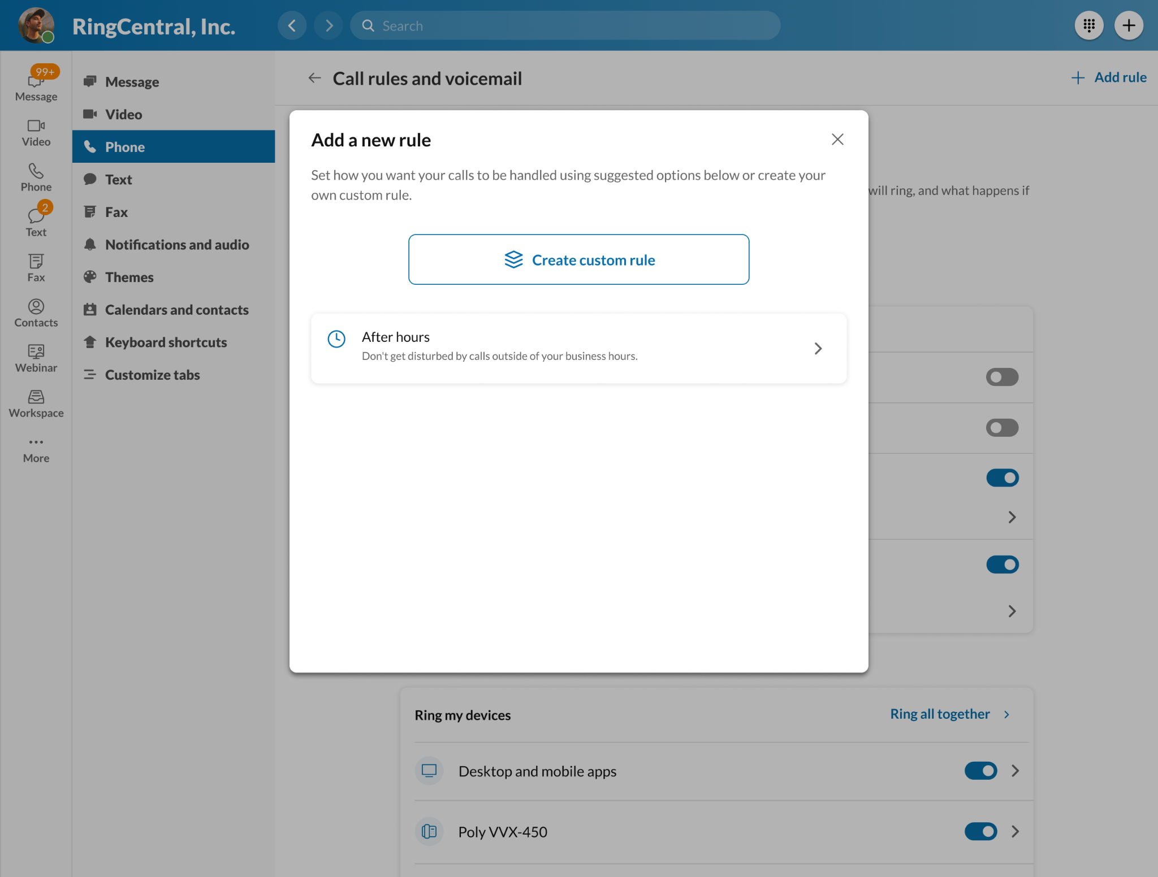
Personal Call Handling
How it works
Create call rules from your Desktop apps
We make it easy to setup any call rule you need

Slide 11
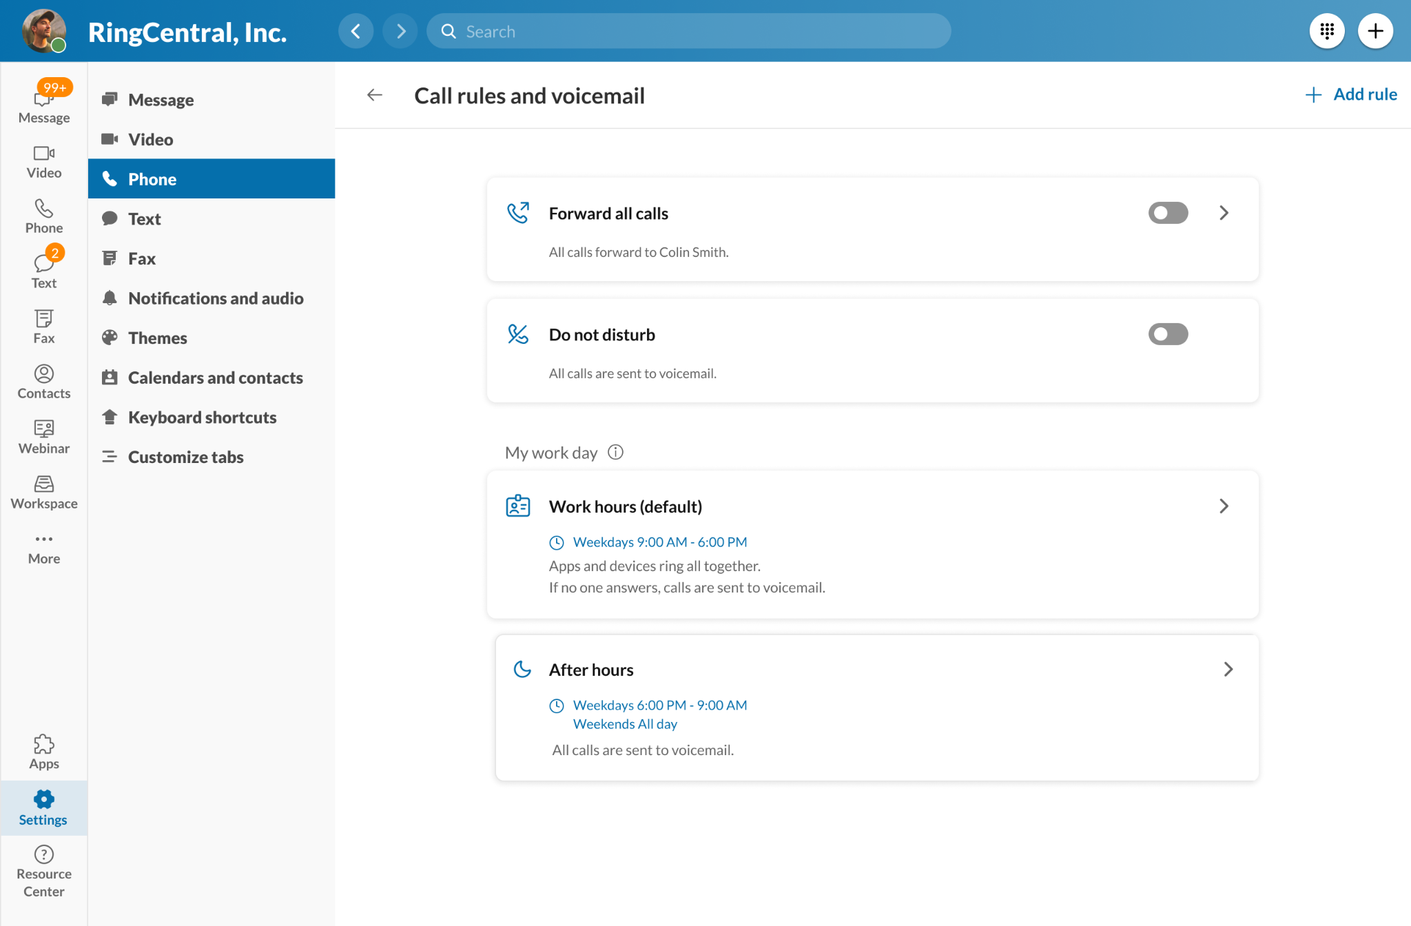
Personal Call Handling
How it works
Call rules are easy to activate and customize

Slide 12
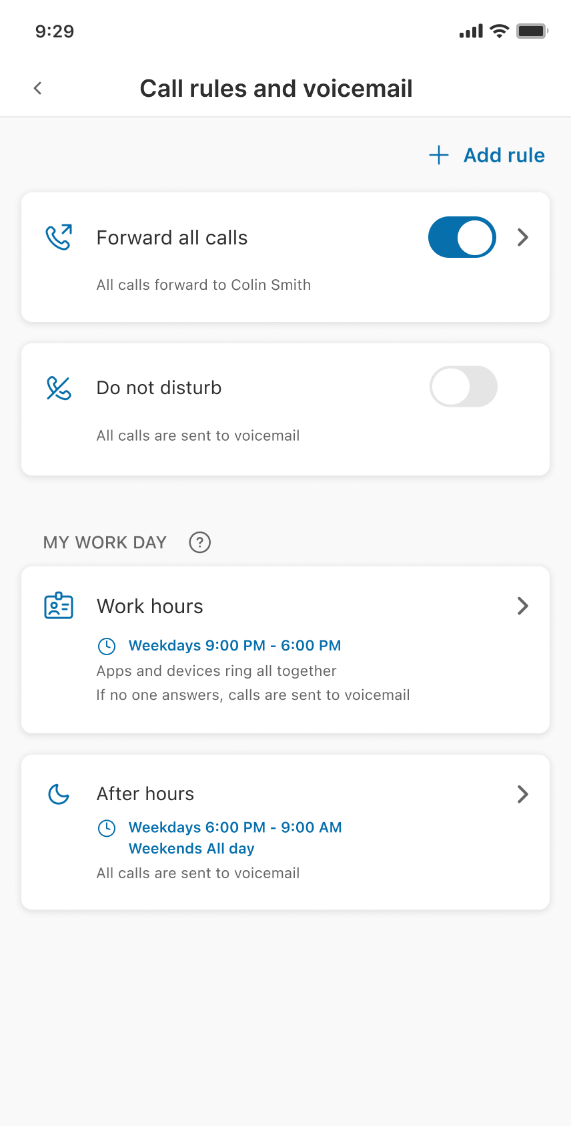
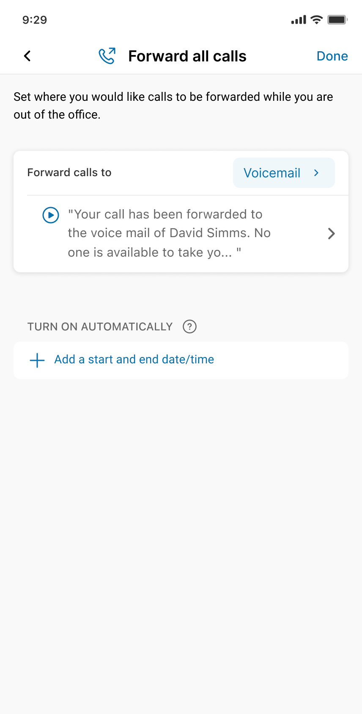
Personal Call Handling
How it works
Forward all calls when your on break or vacation.

Slide 13
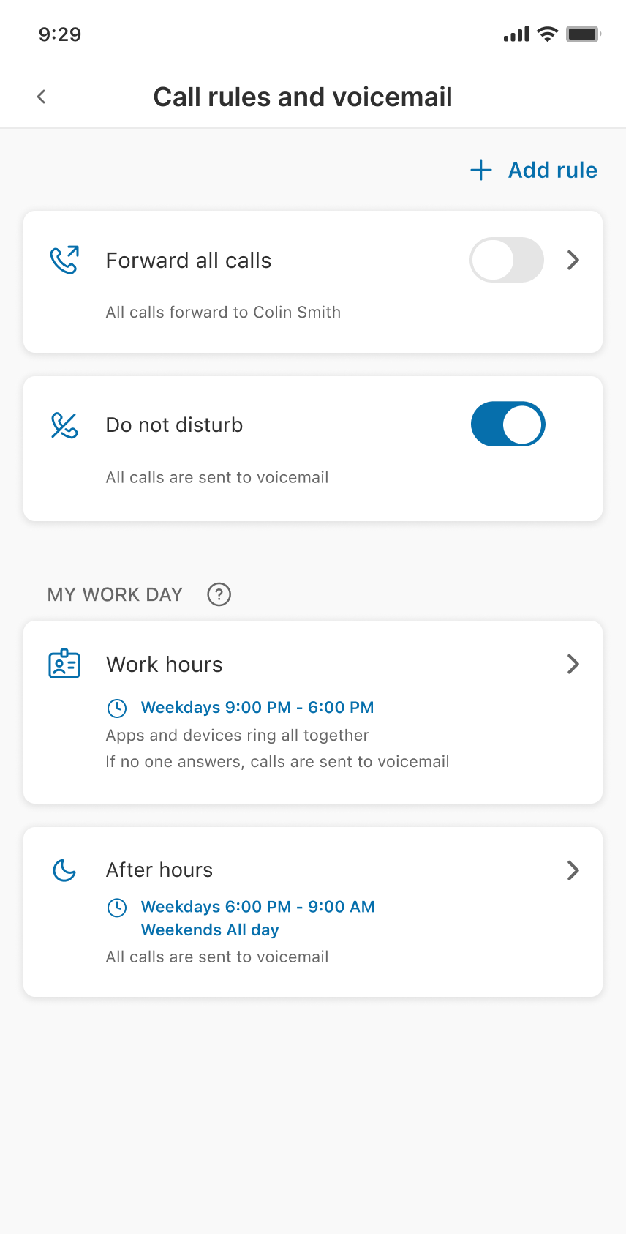
Personal Call Handling
How it works
Turn on Do Not Disturb when you need quiet time

Slide 14
Personal Call Handling
How it works
Customize how incoming calls are handled while you are at work

Slide 15
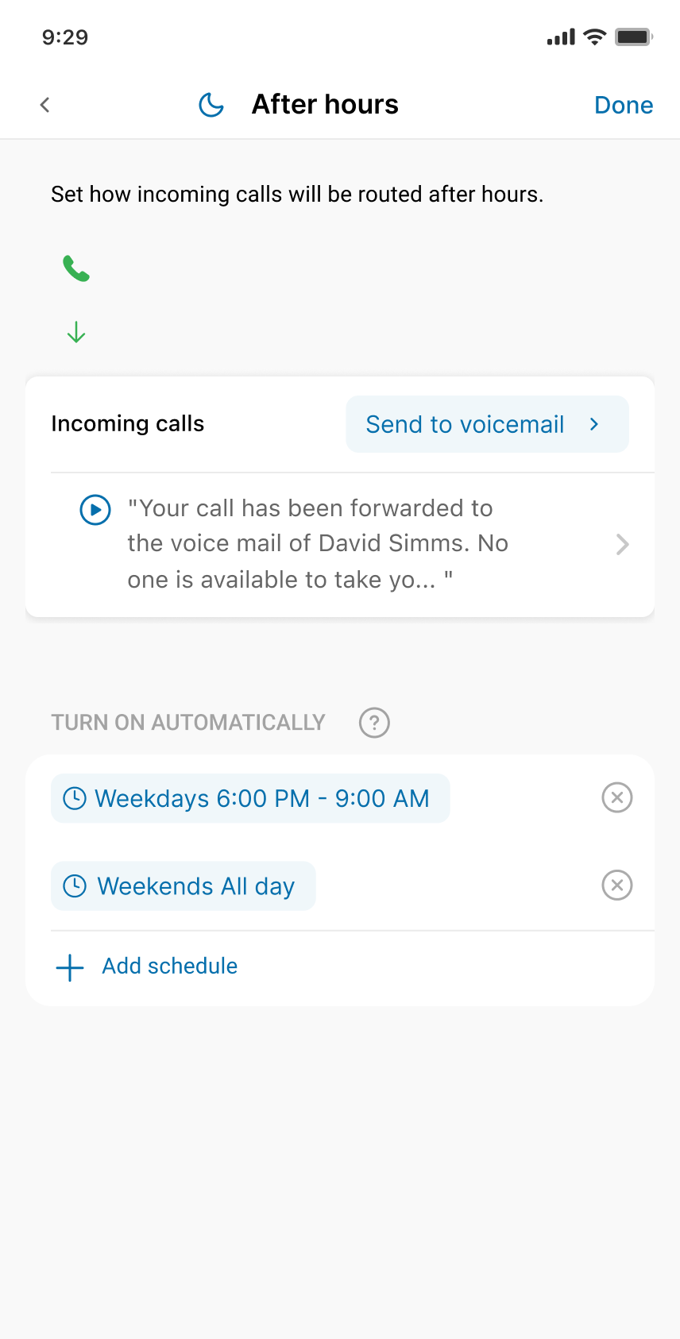
Personal Call Handling
How it works
Customize how incoming calls are handled while you’re not at work

Slide 16
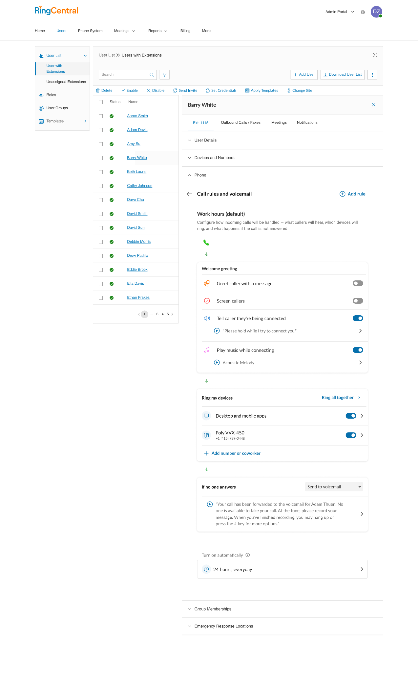
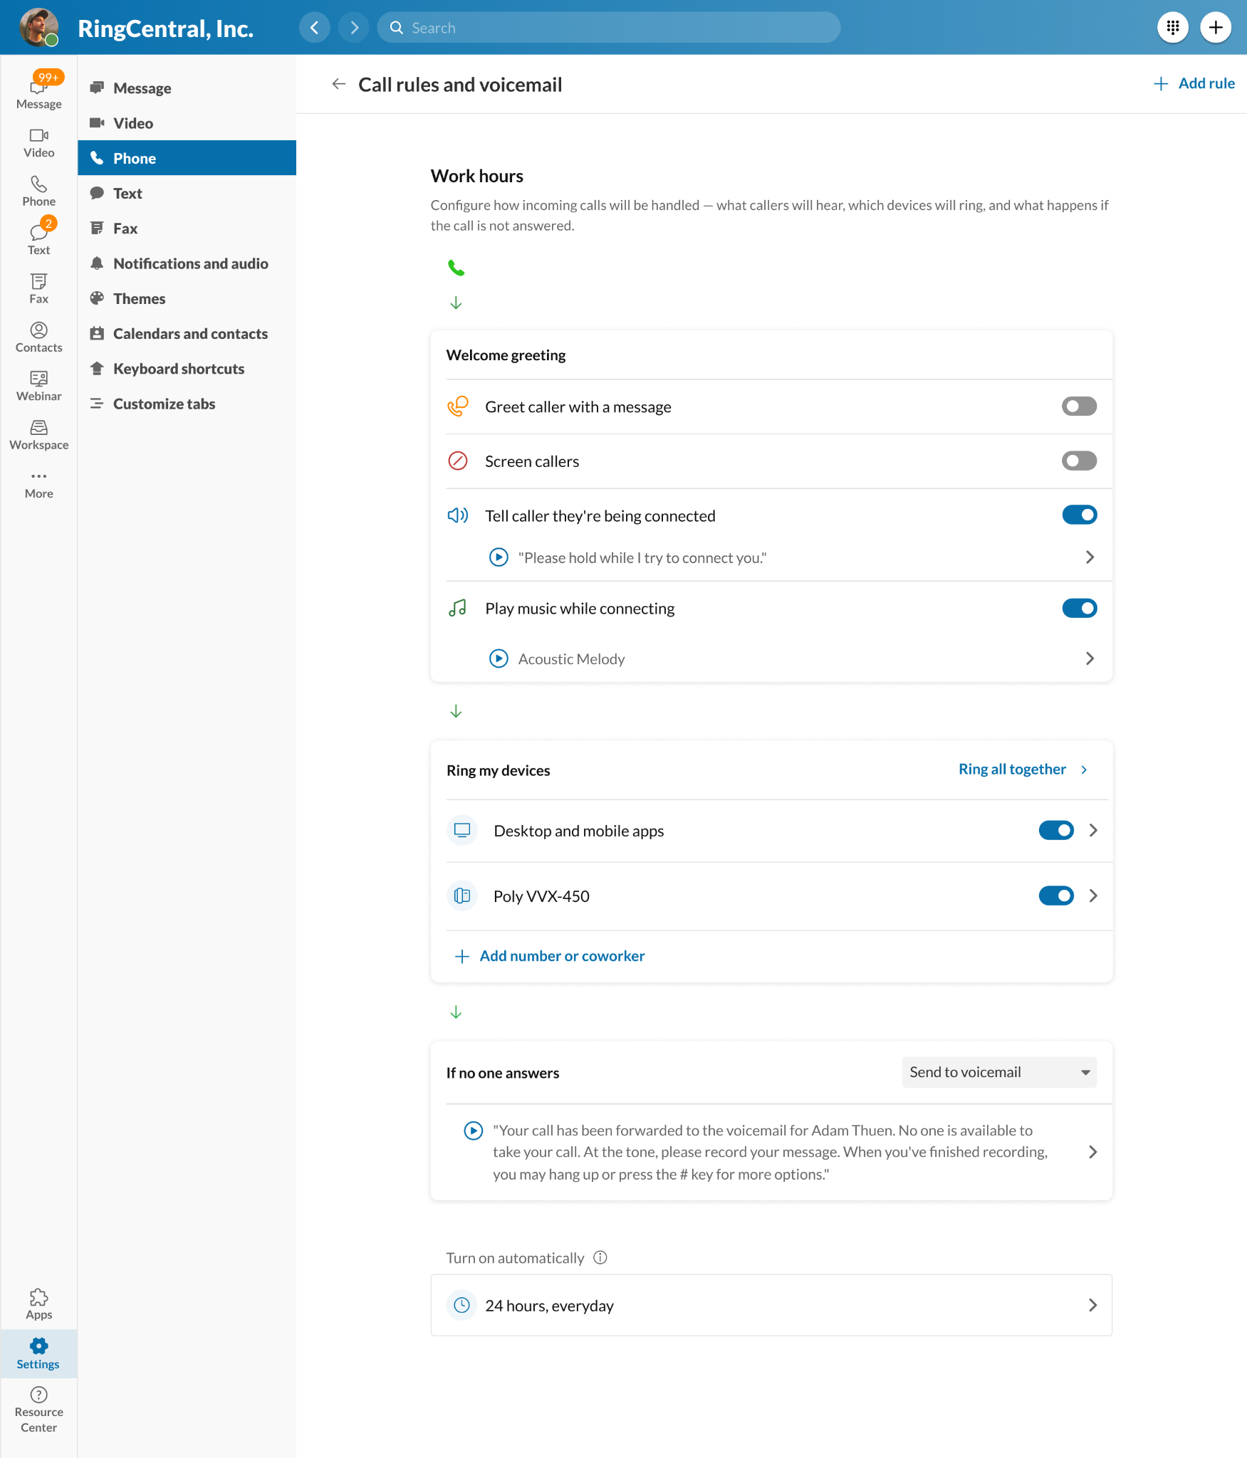
Personal Call Handling
Admin Portal
How it works
Desktop App
Set your call rules from anywhere:
Mobile apps
Desktop apps
Admin portals

Slide 17
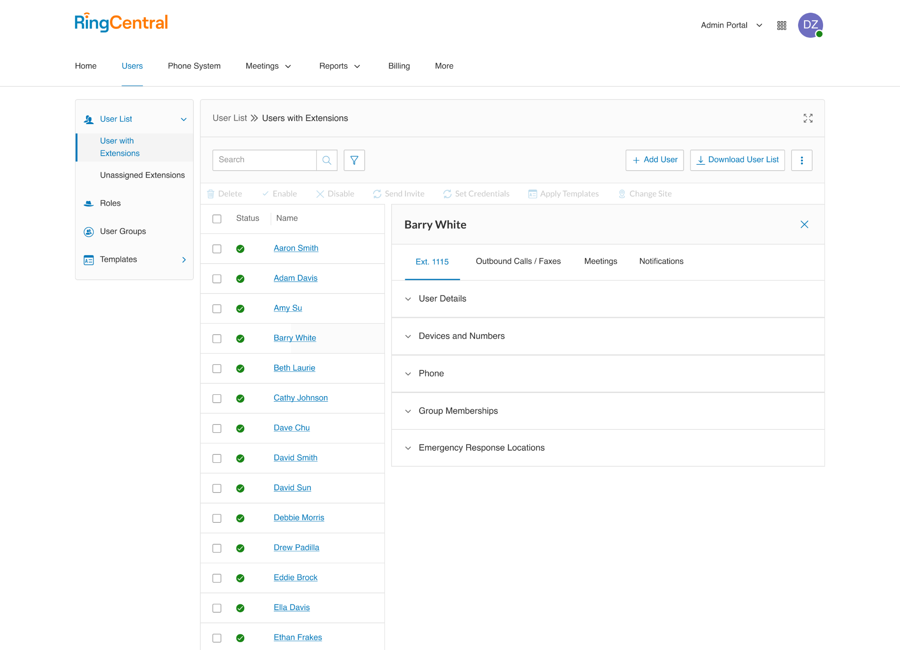
Personal Call Handling
How it works
In the Admin Portal:
User Greetings, Call handling, and Voicemail sections have been consolidated into Phone settings

Slide 18
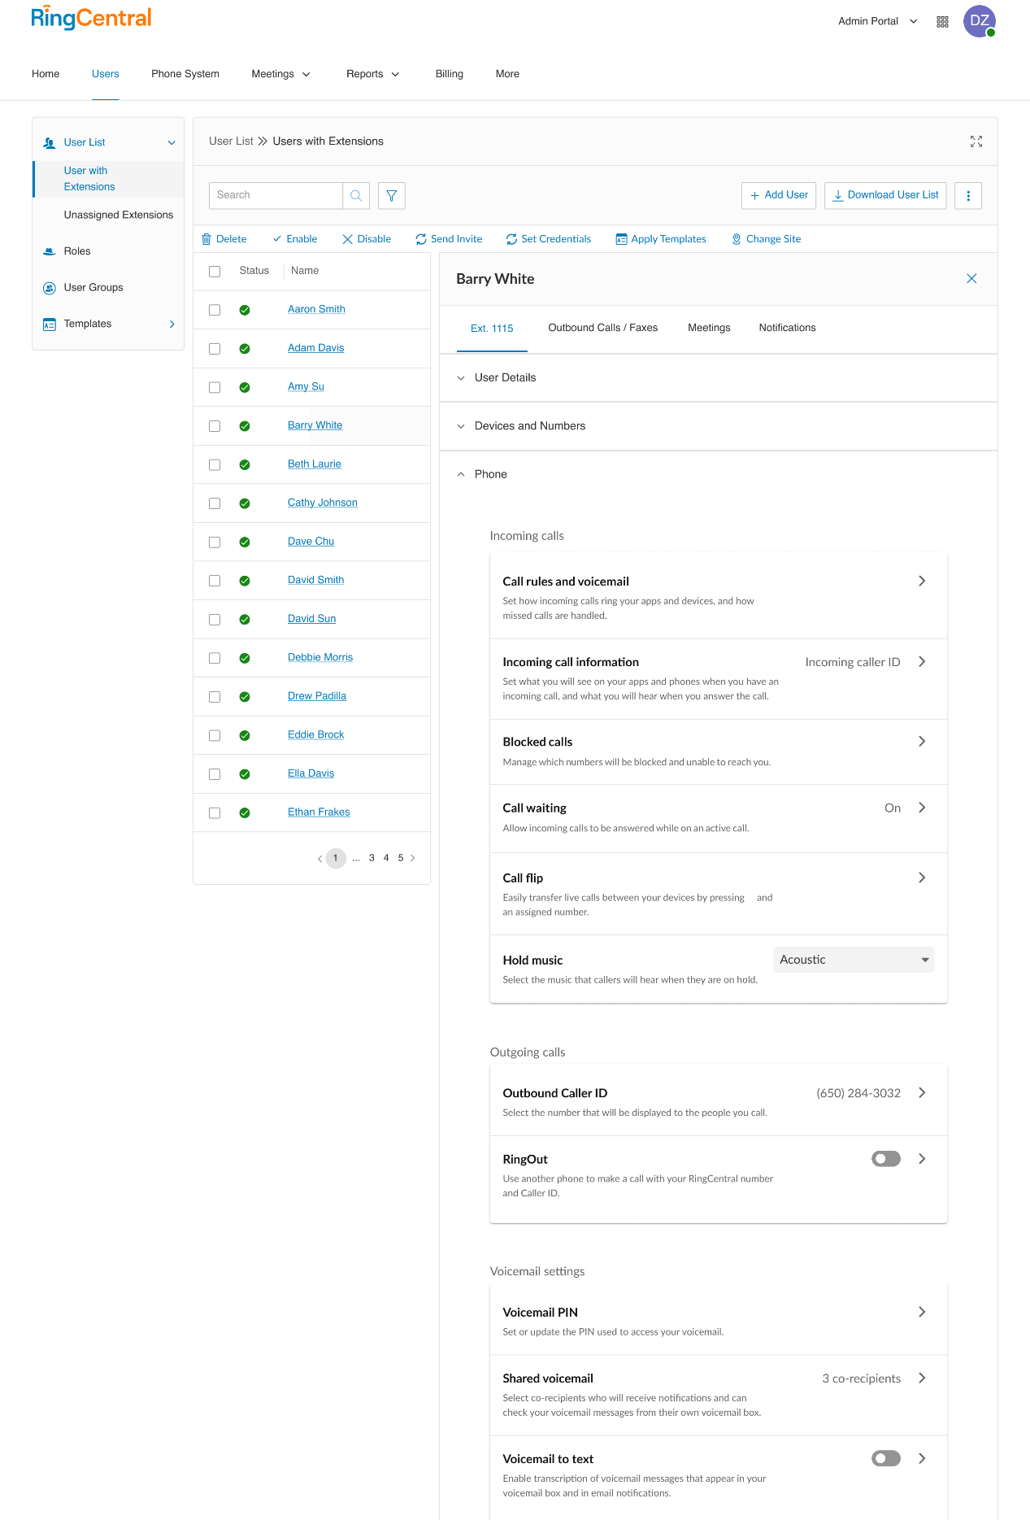
Personal Call Handling
How it works
Phone settings in the Admin portal are now the same as in Desktop & Mobile apps

Slide 19
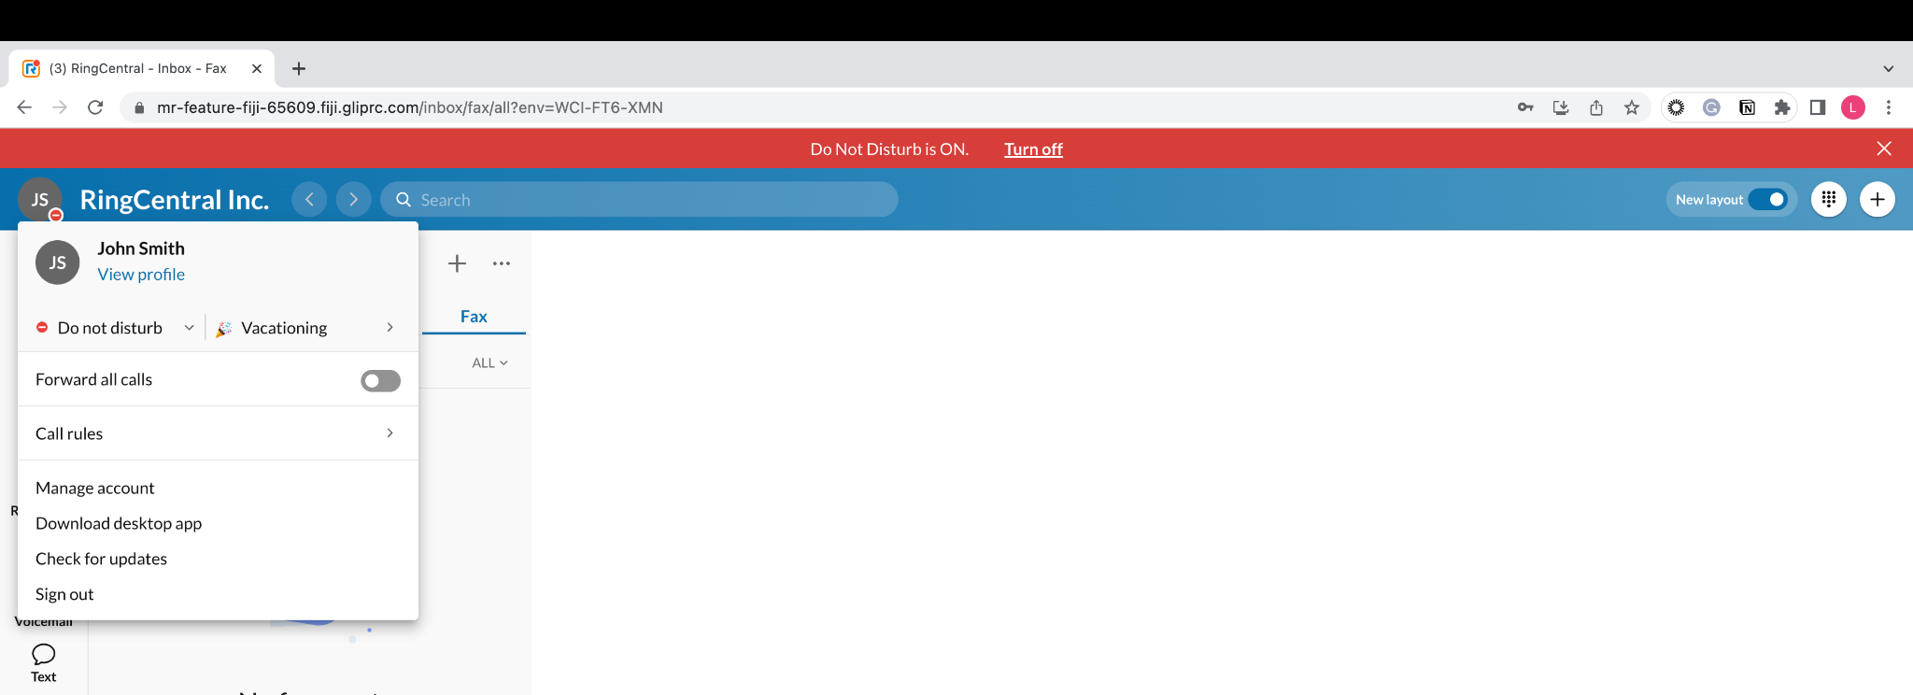
Personal Call Handling
How it works
Set your Presence & Status in the Profile menu

Slide 20
Required Clients
Personal Call Handling
Soft clients
RingCentral App Desktop, Mobile, Web v23.2.30 (or later)
RC Phone Desktop v23.2.30 (or later)

Slide 21
Personal Call Handling
FAQ
Do you support role-based permissions to control which call settings users can view and change?
Yes. Everyone will be able to view phone and call rule settings by default. To allow users to edit phone and call rule settings, assign the desired permission(s). For example ..
To record and change the voicemail greeting, assign the Voicemail permission
To customize the greetings played to incoming callers, assign the Screening, Greeting, and Hold Music permission.
To edit and add call rules, assign the Call handling permission.
Can I view/edit call rule settings using RC App for MS Teams?
Yes. In MS Teams, open RC App and select Settings > Phone > Call rules to access your call rule settings.

Slide 22
Thank You

